Slide 1

VelNet: A Simple and Versatile Open-source Networking Framework for XR Research Labs

Slide 2
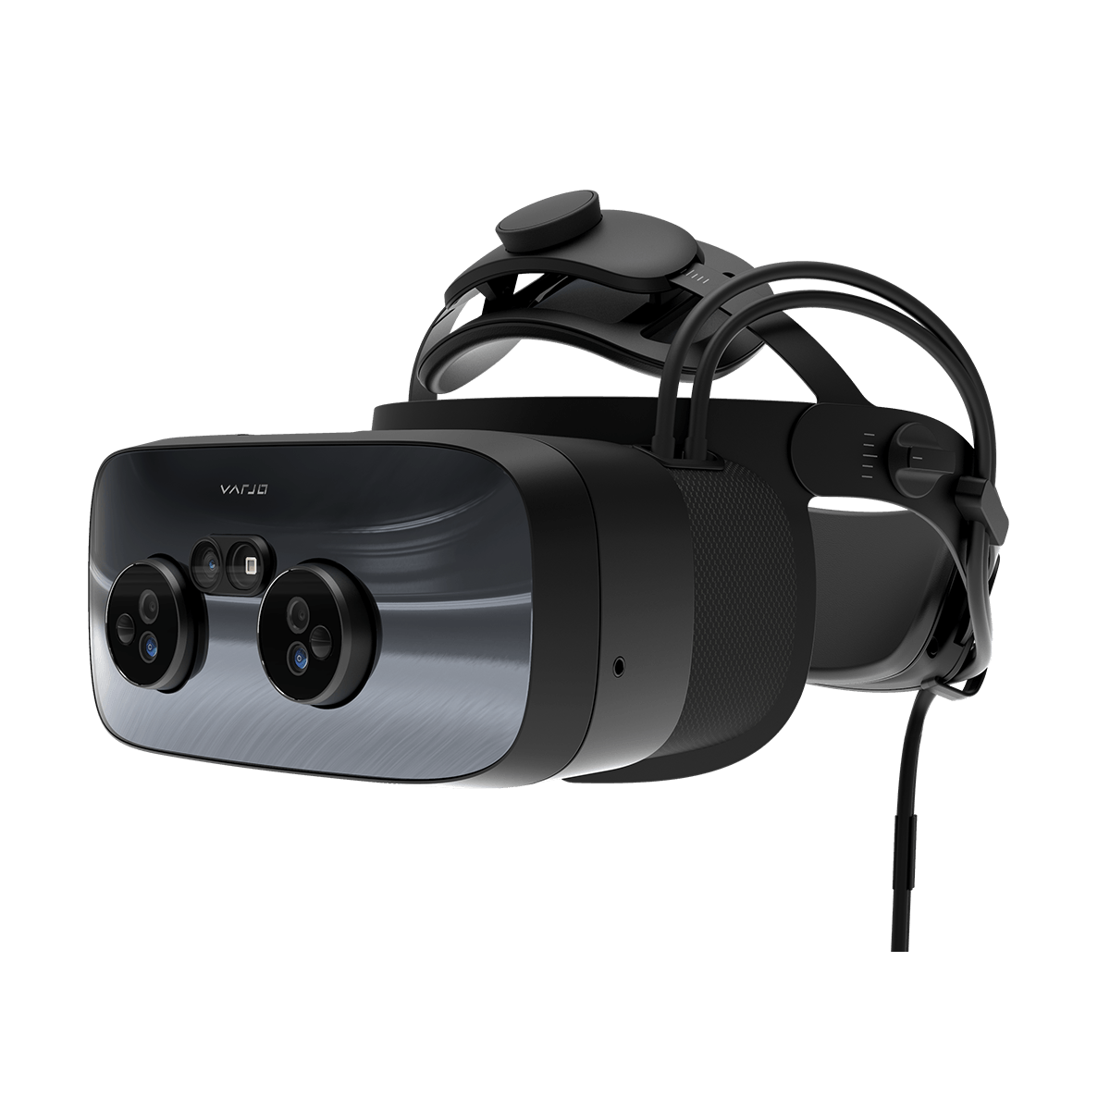
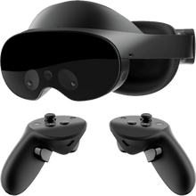
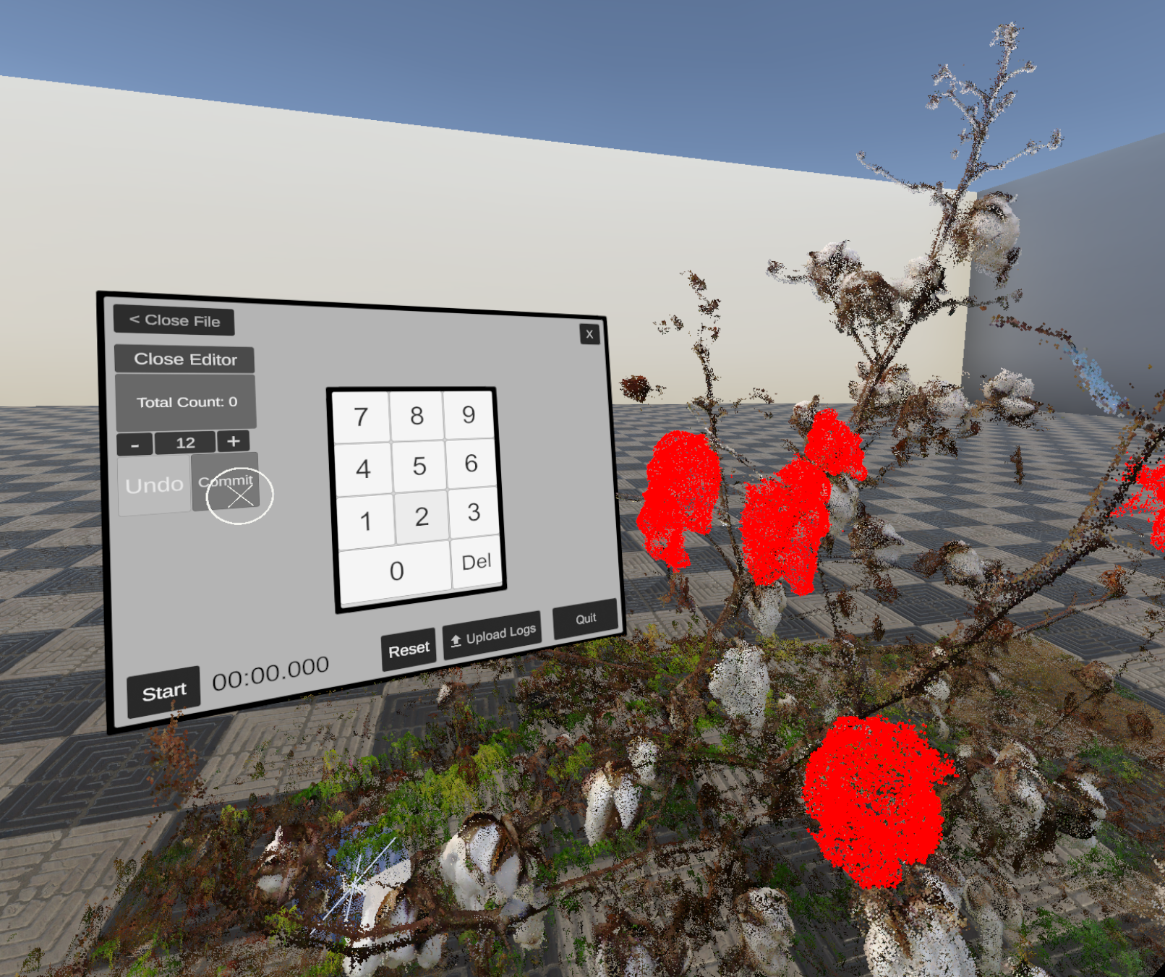
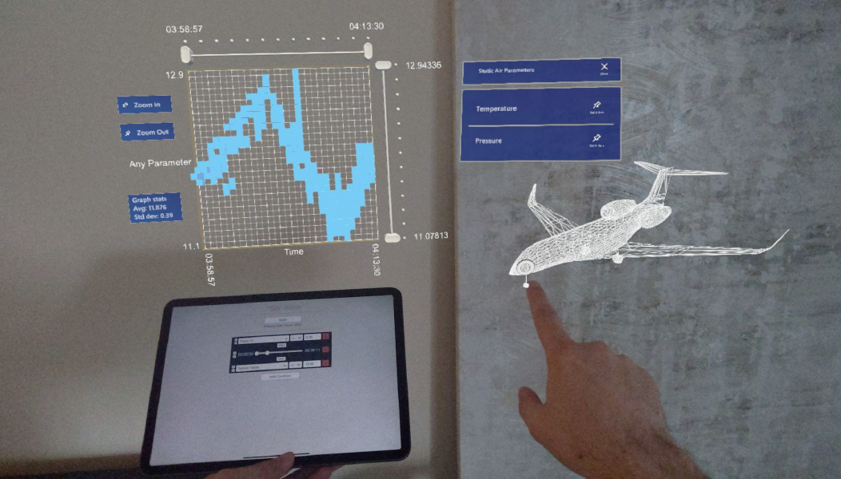
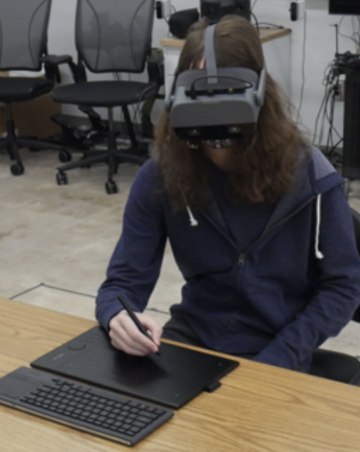
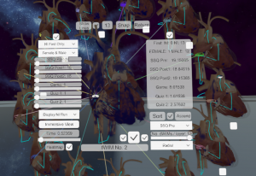
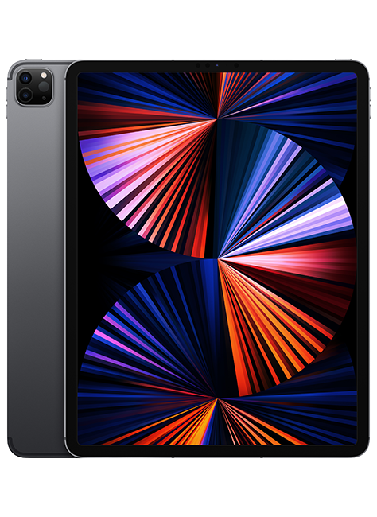
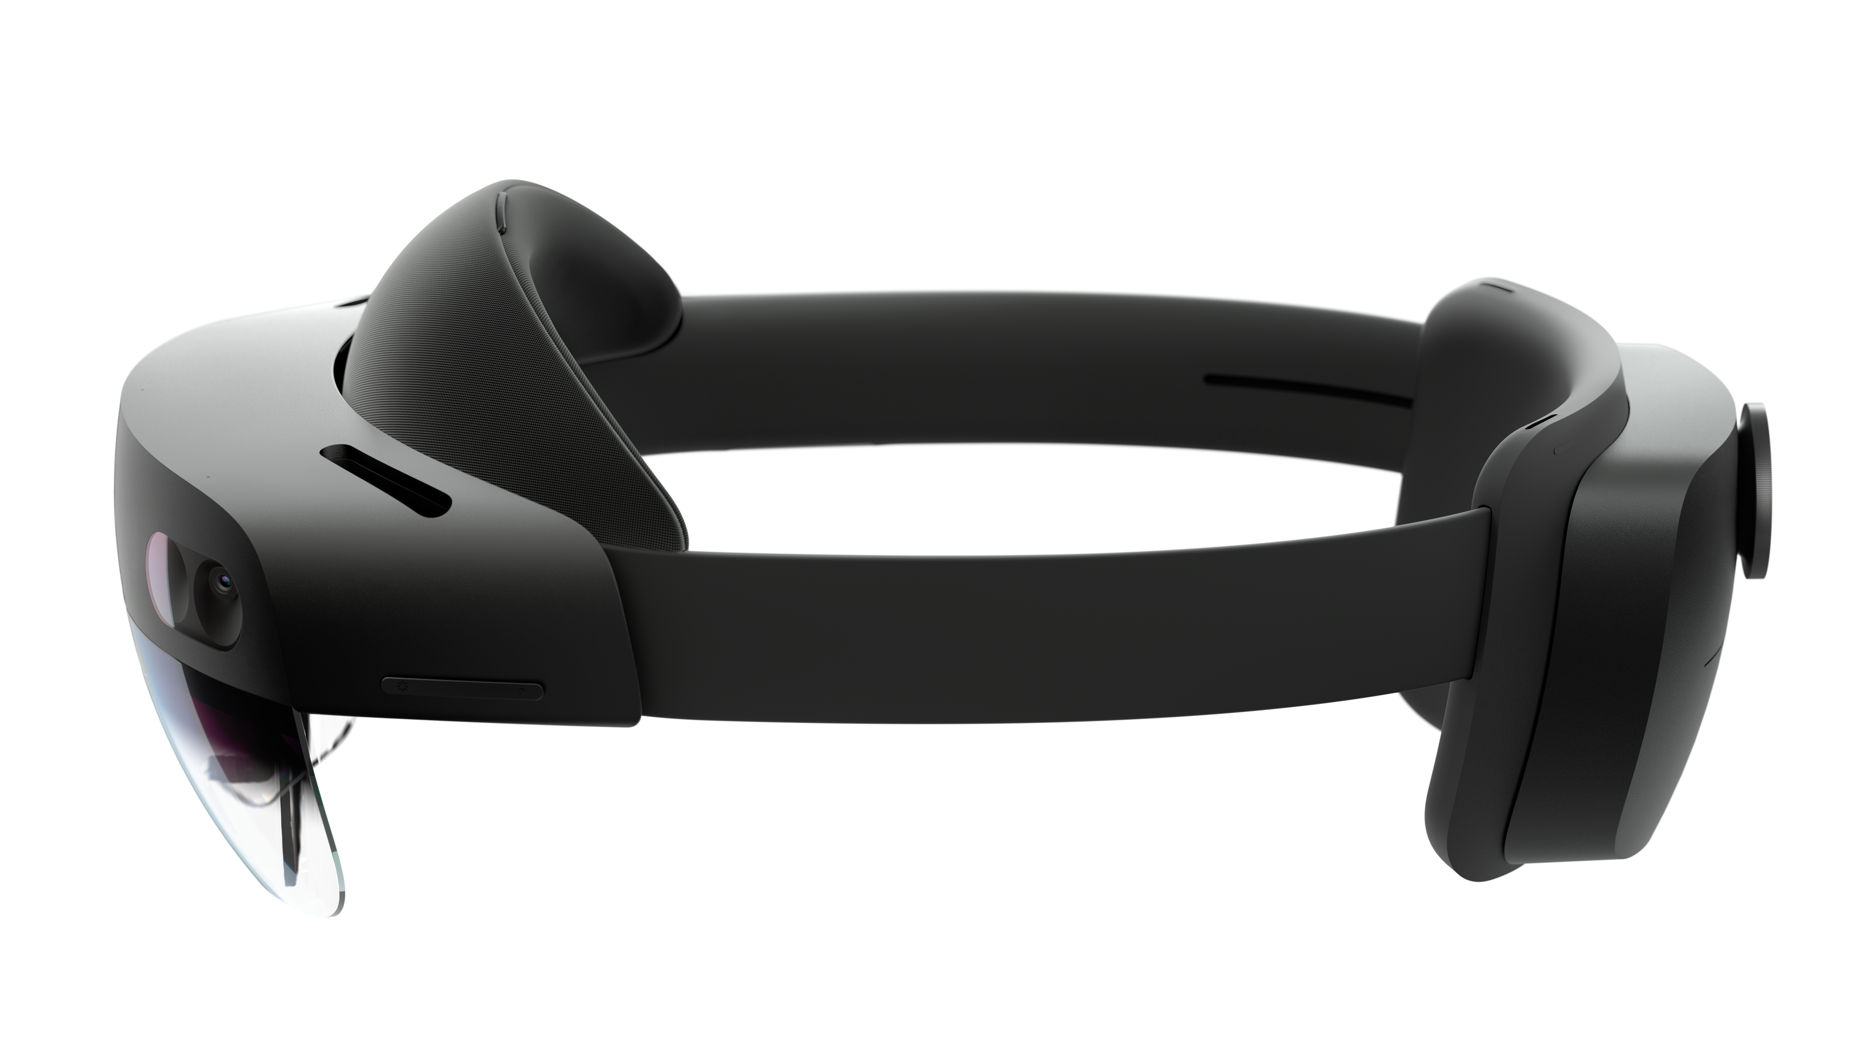
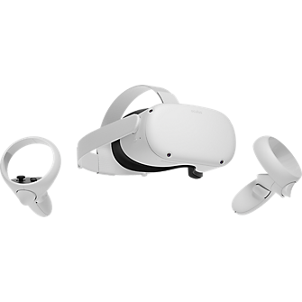
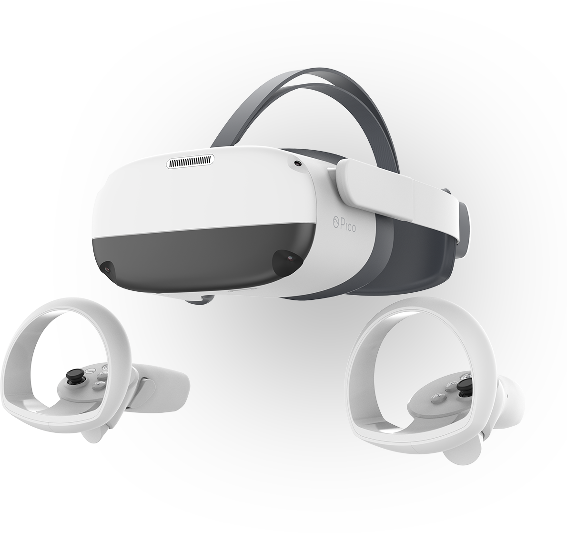
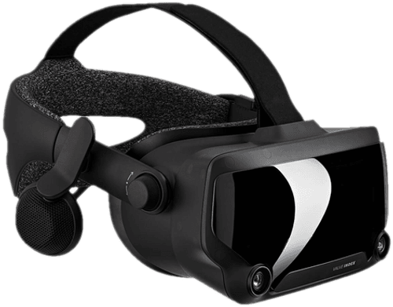
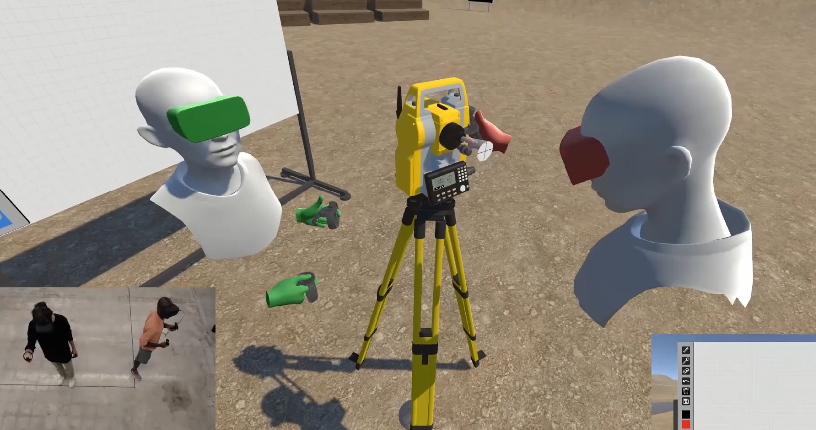
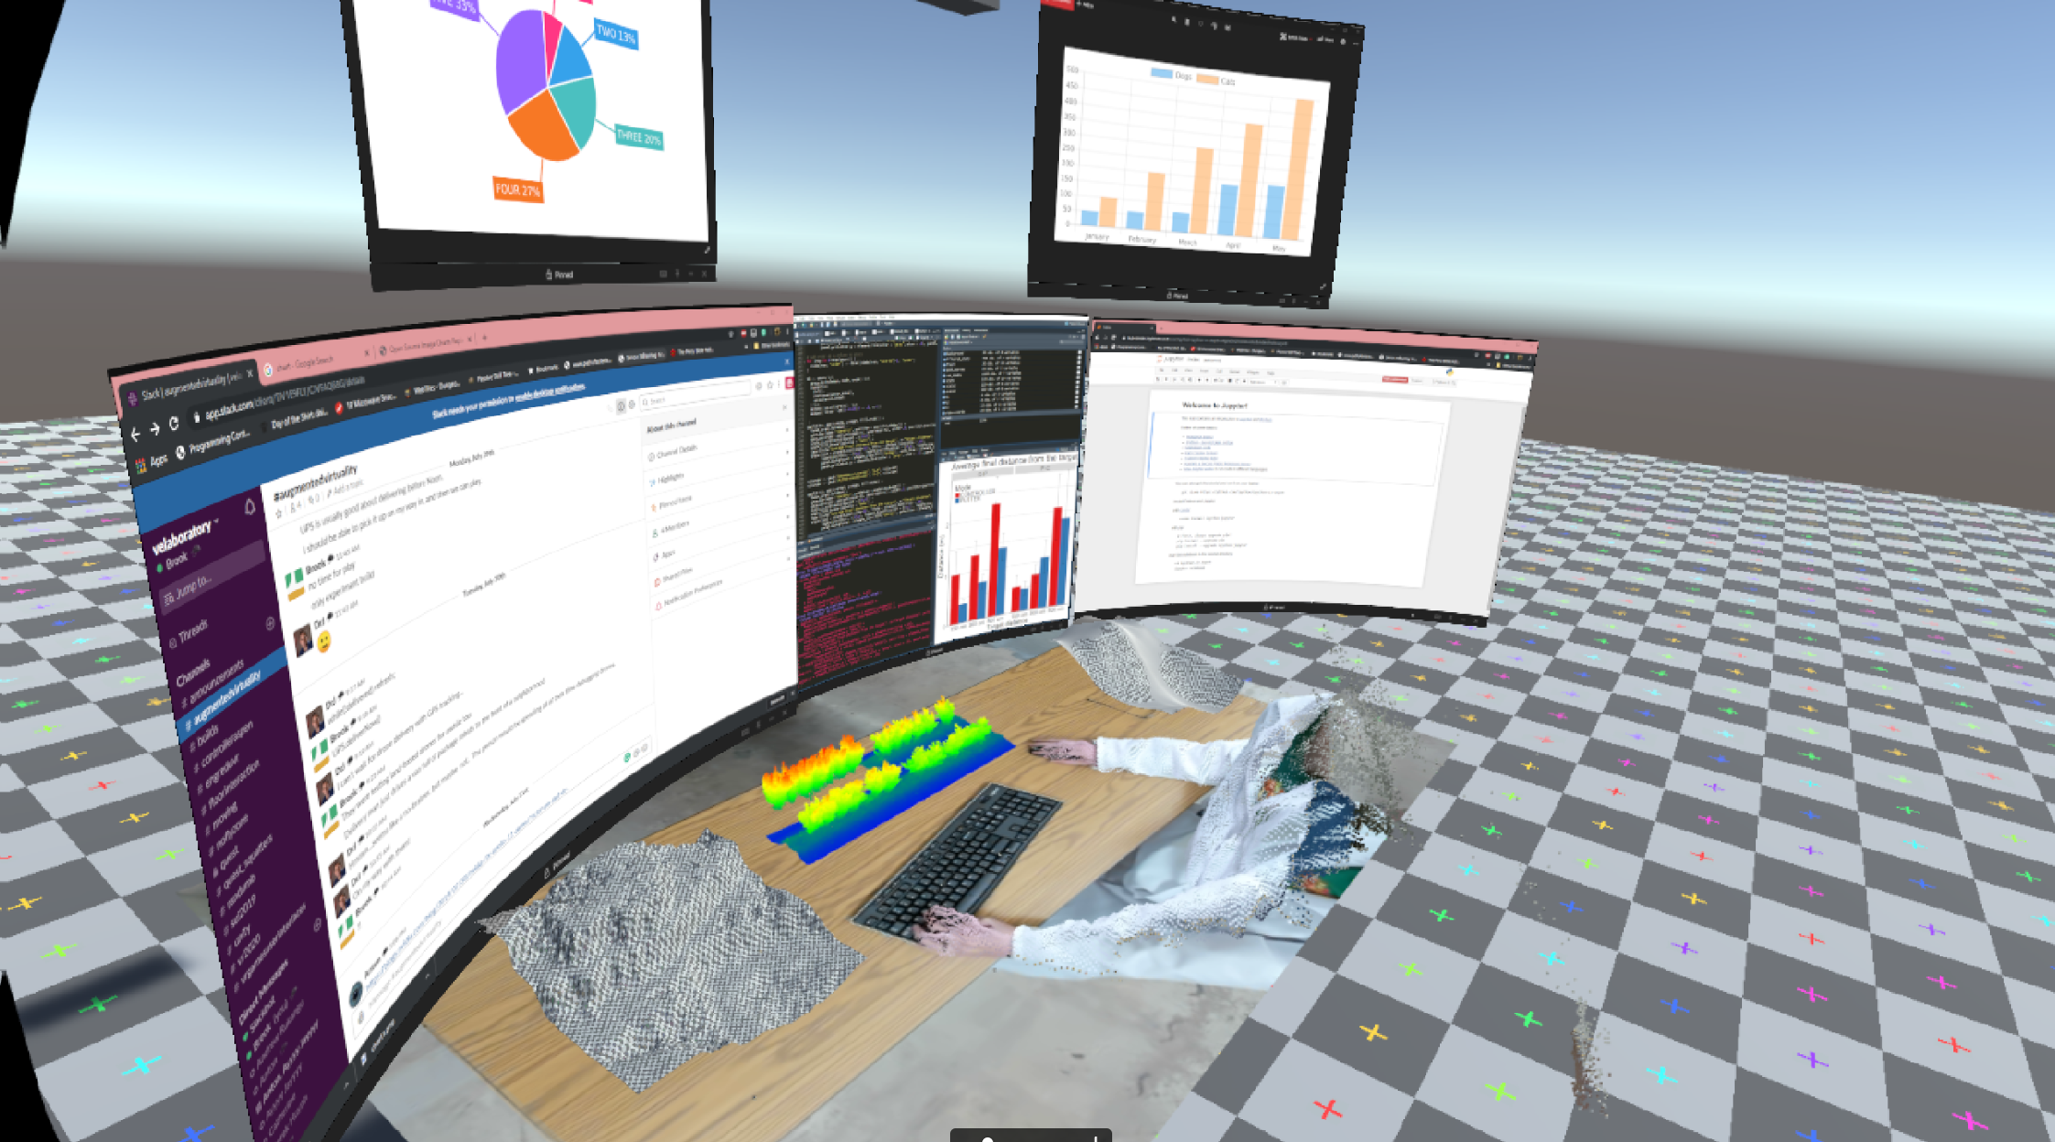
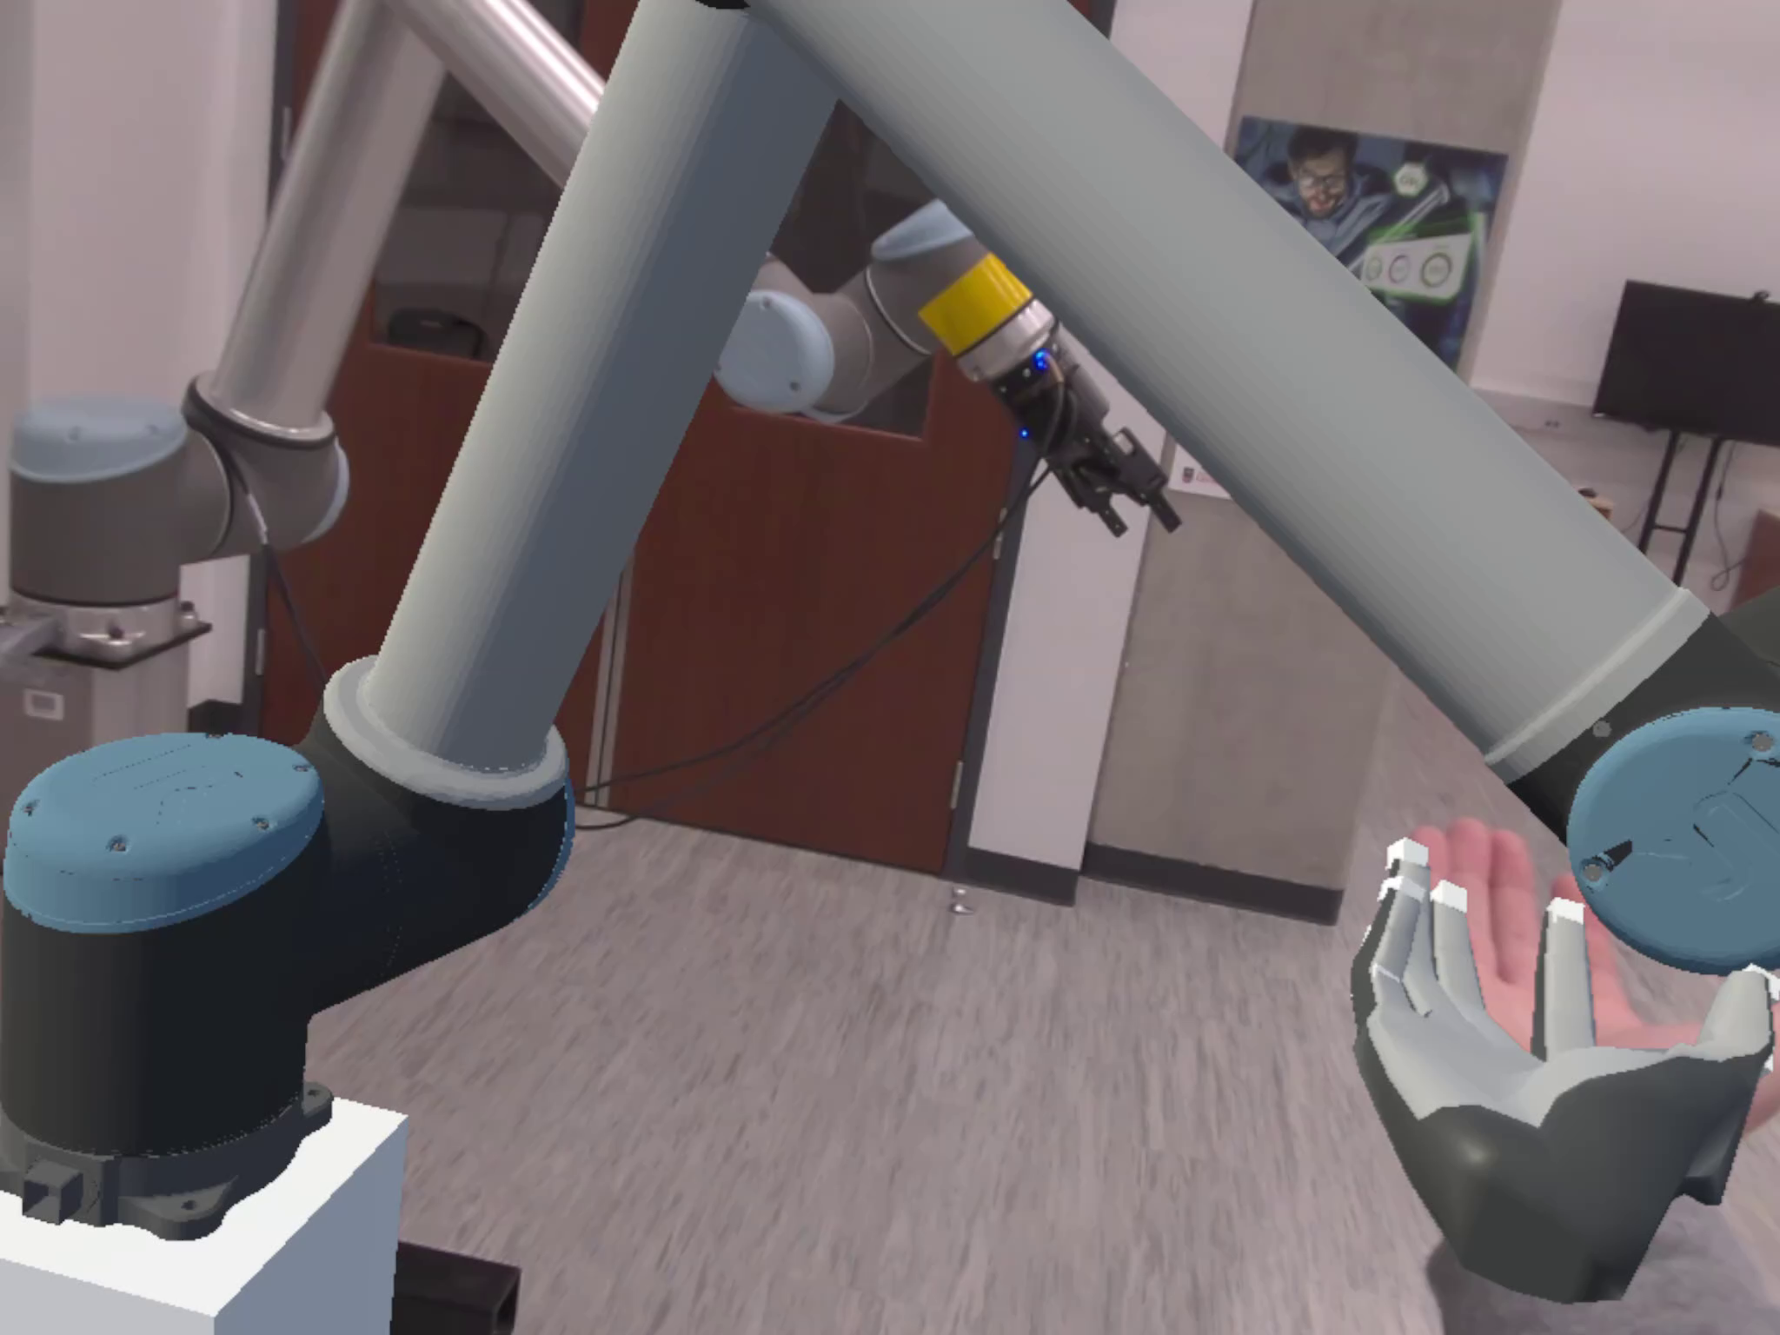
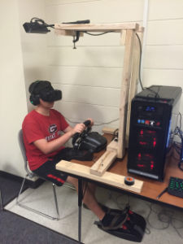
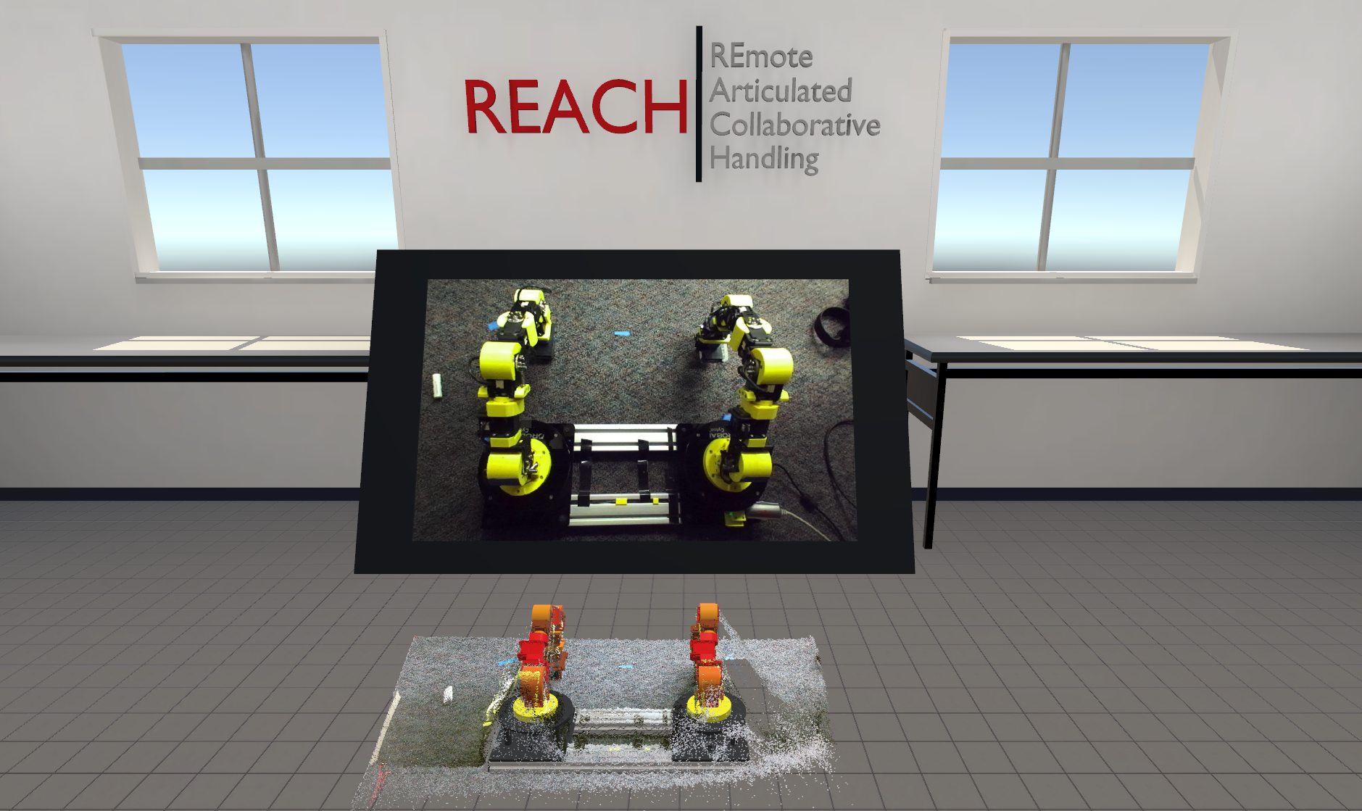
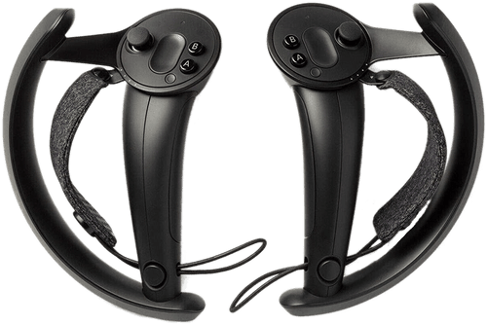
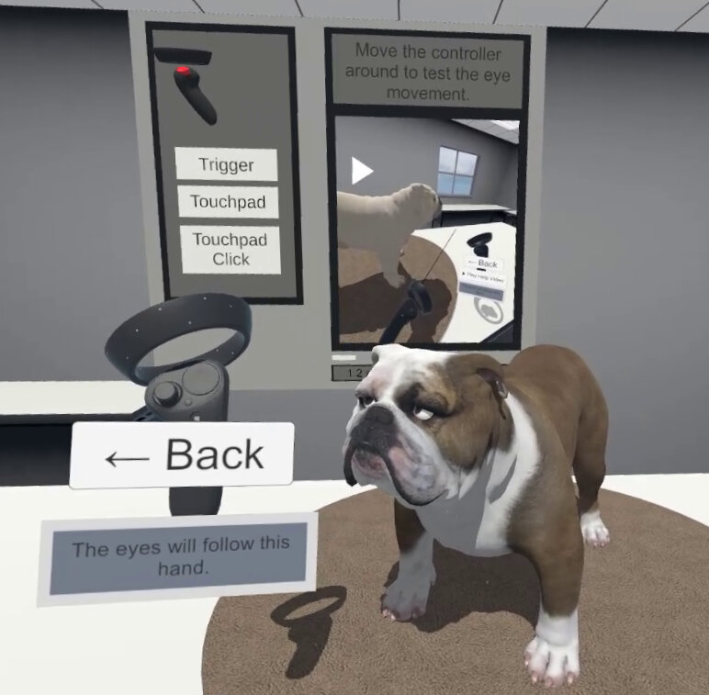
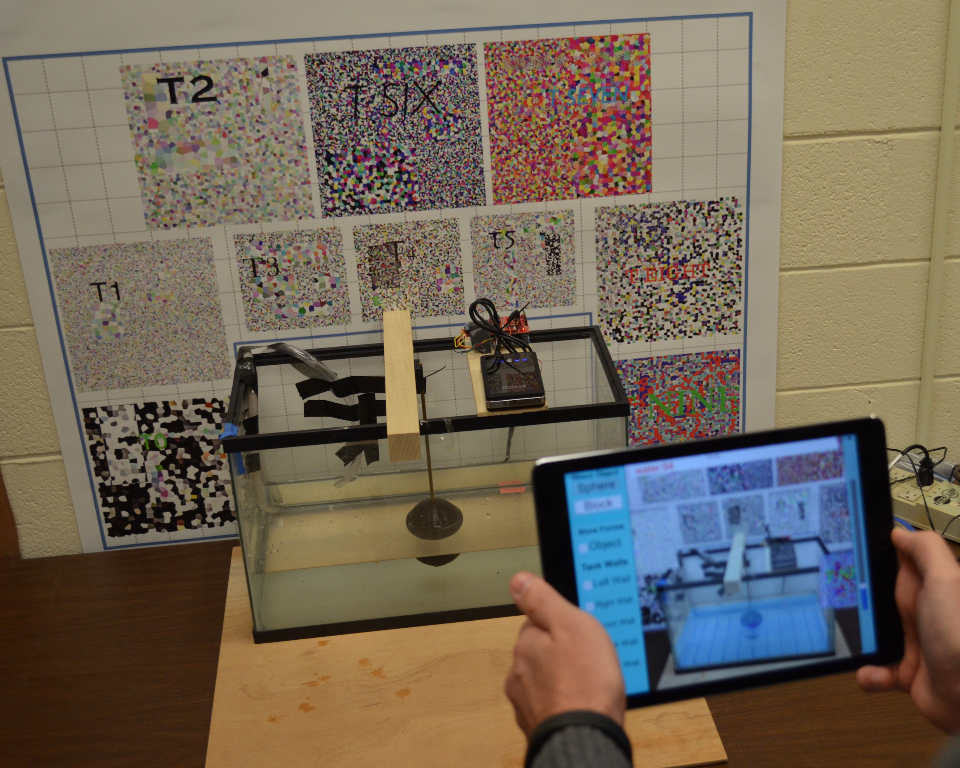
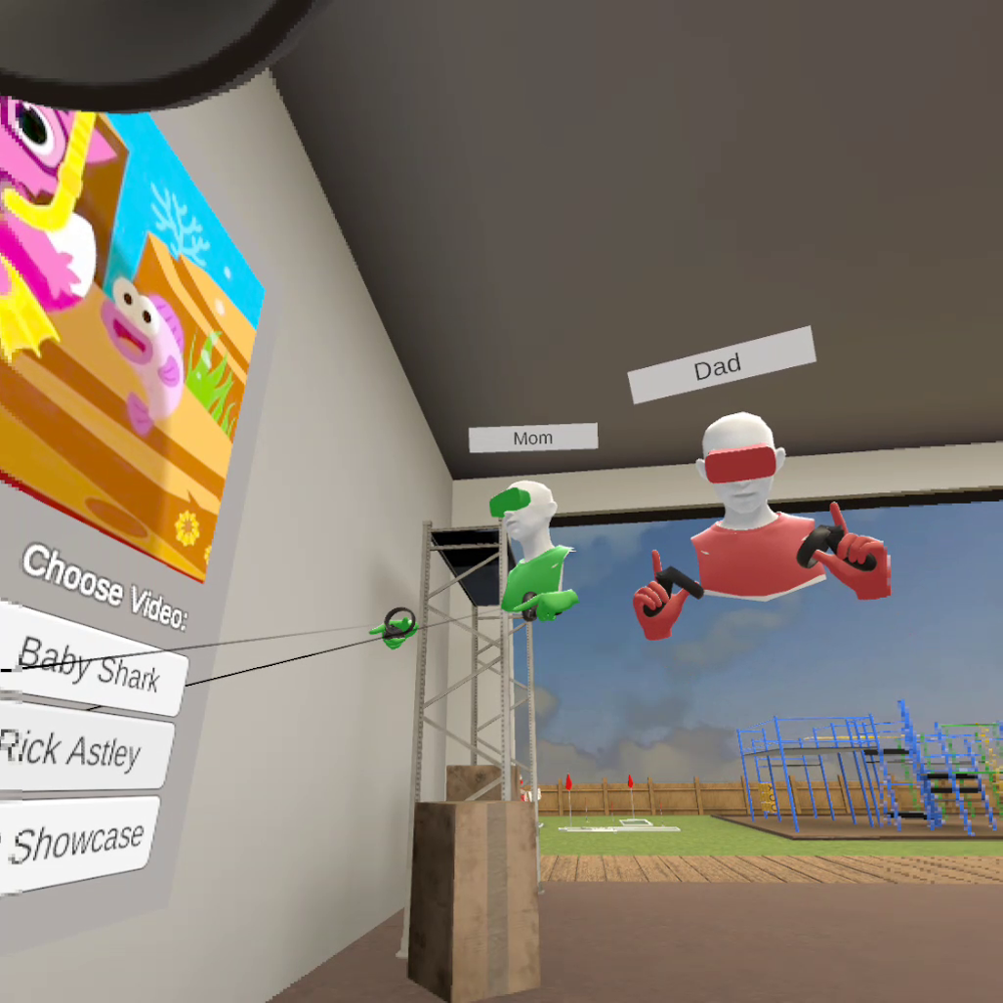

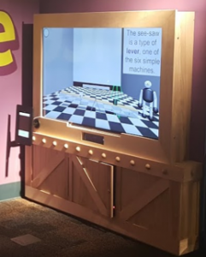
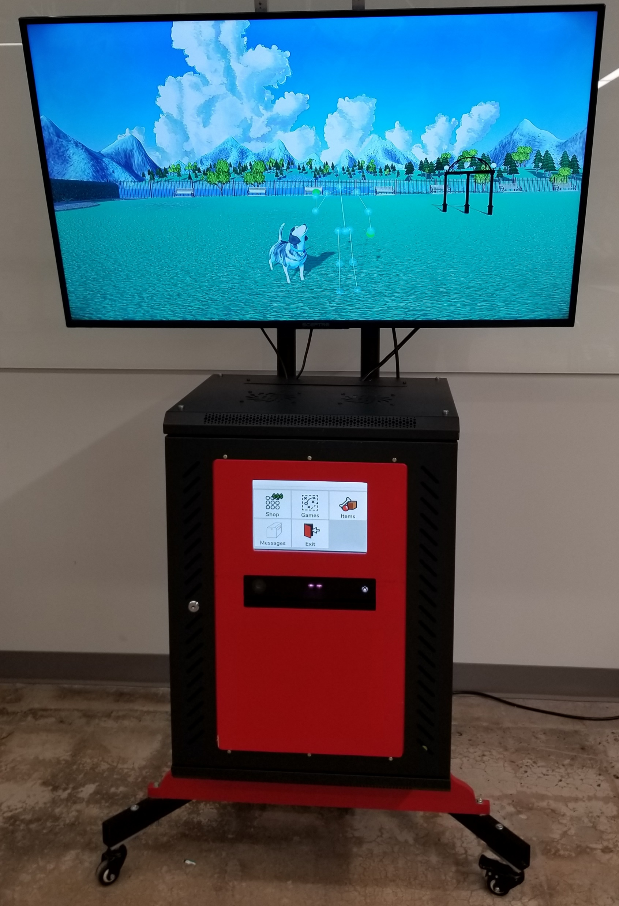
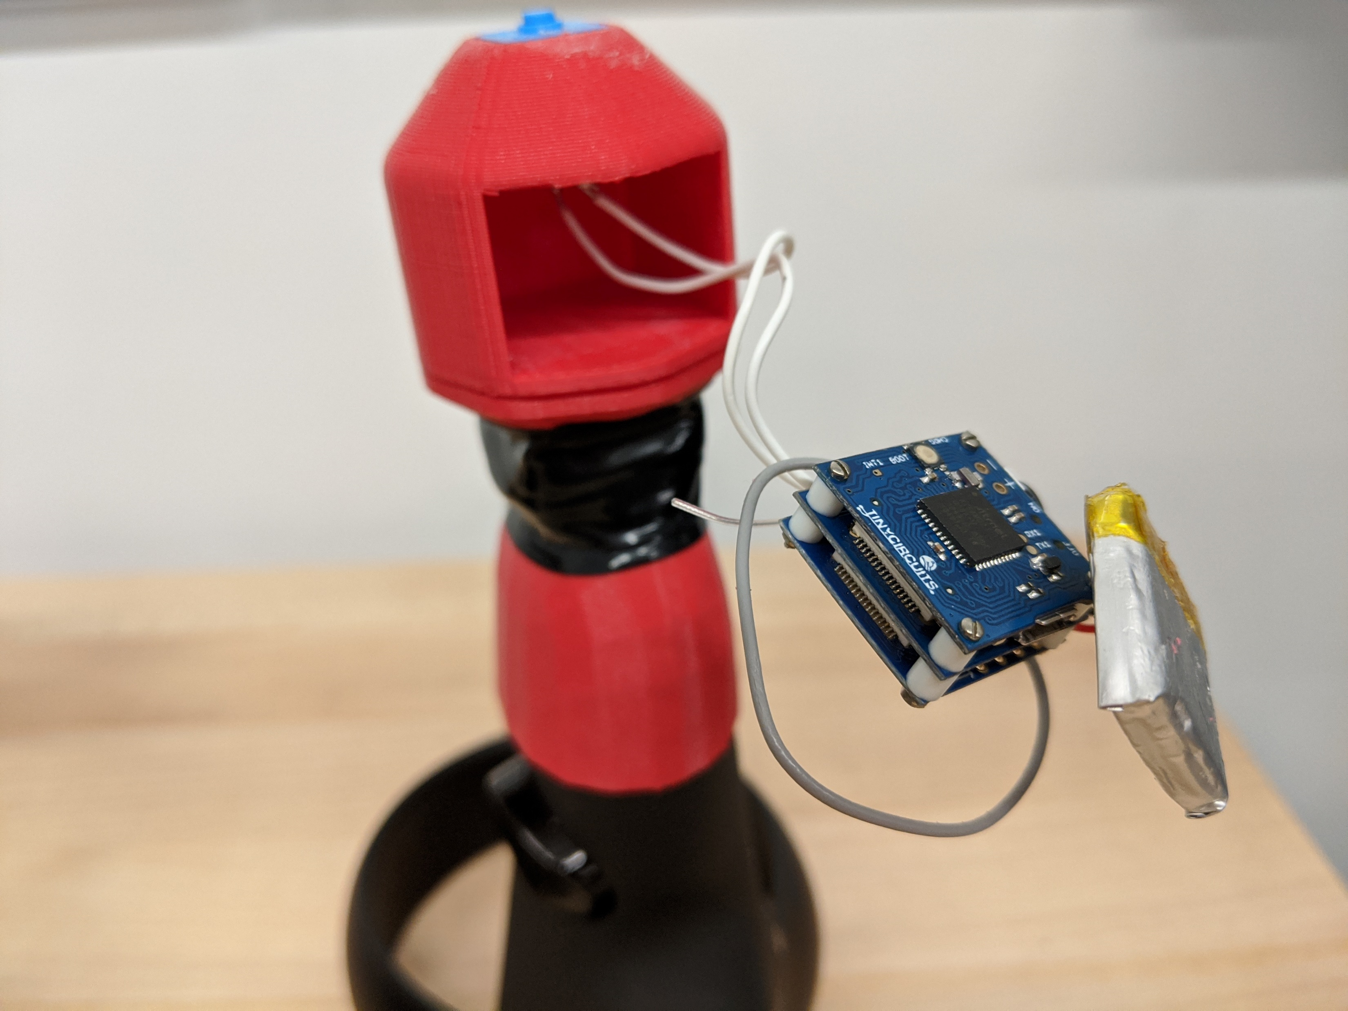
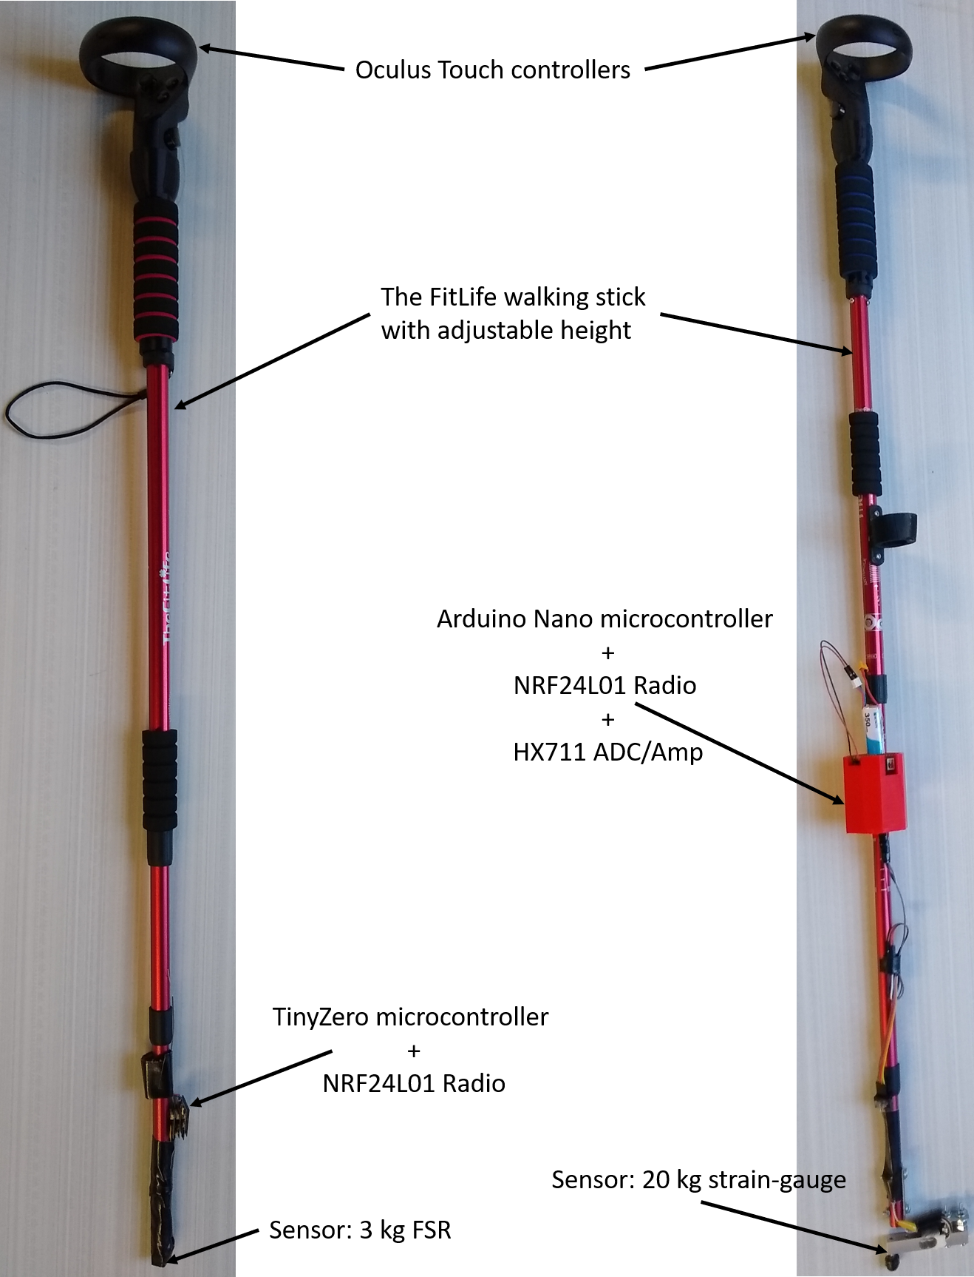
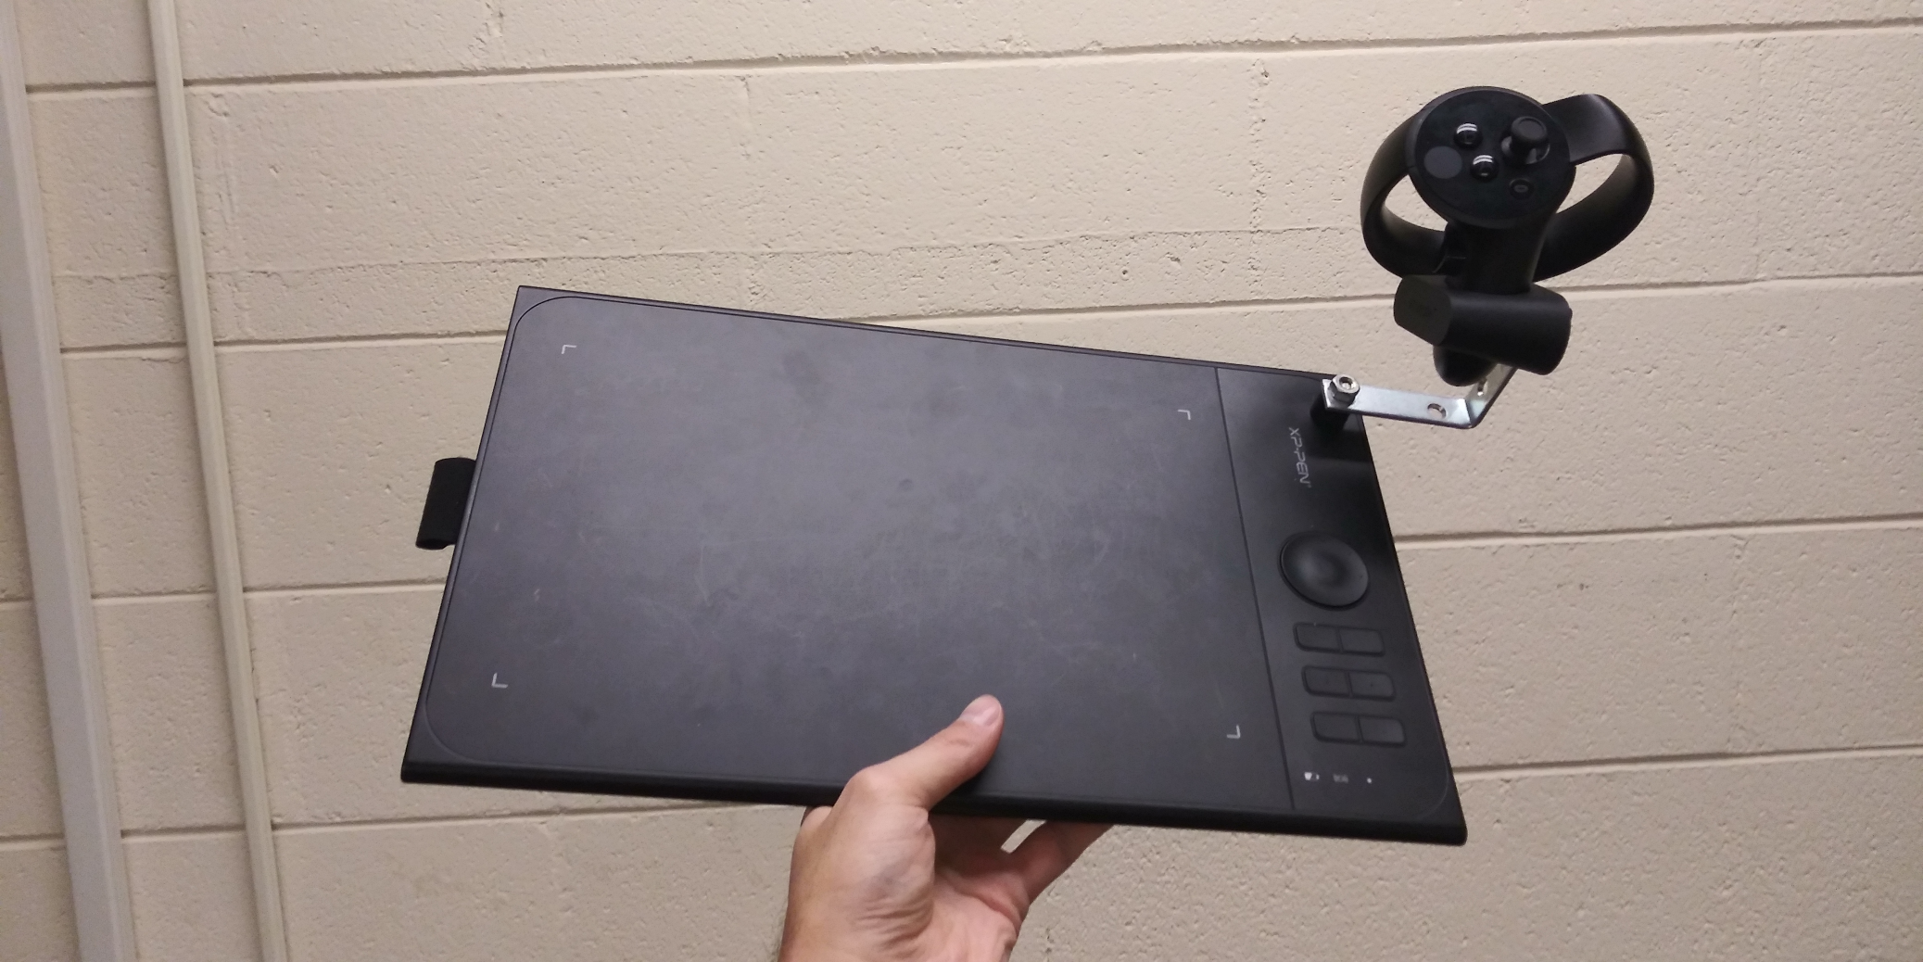
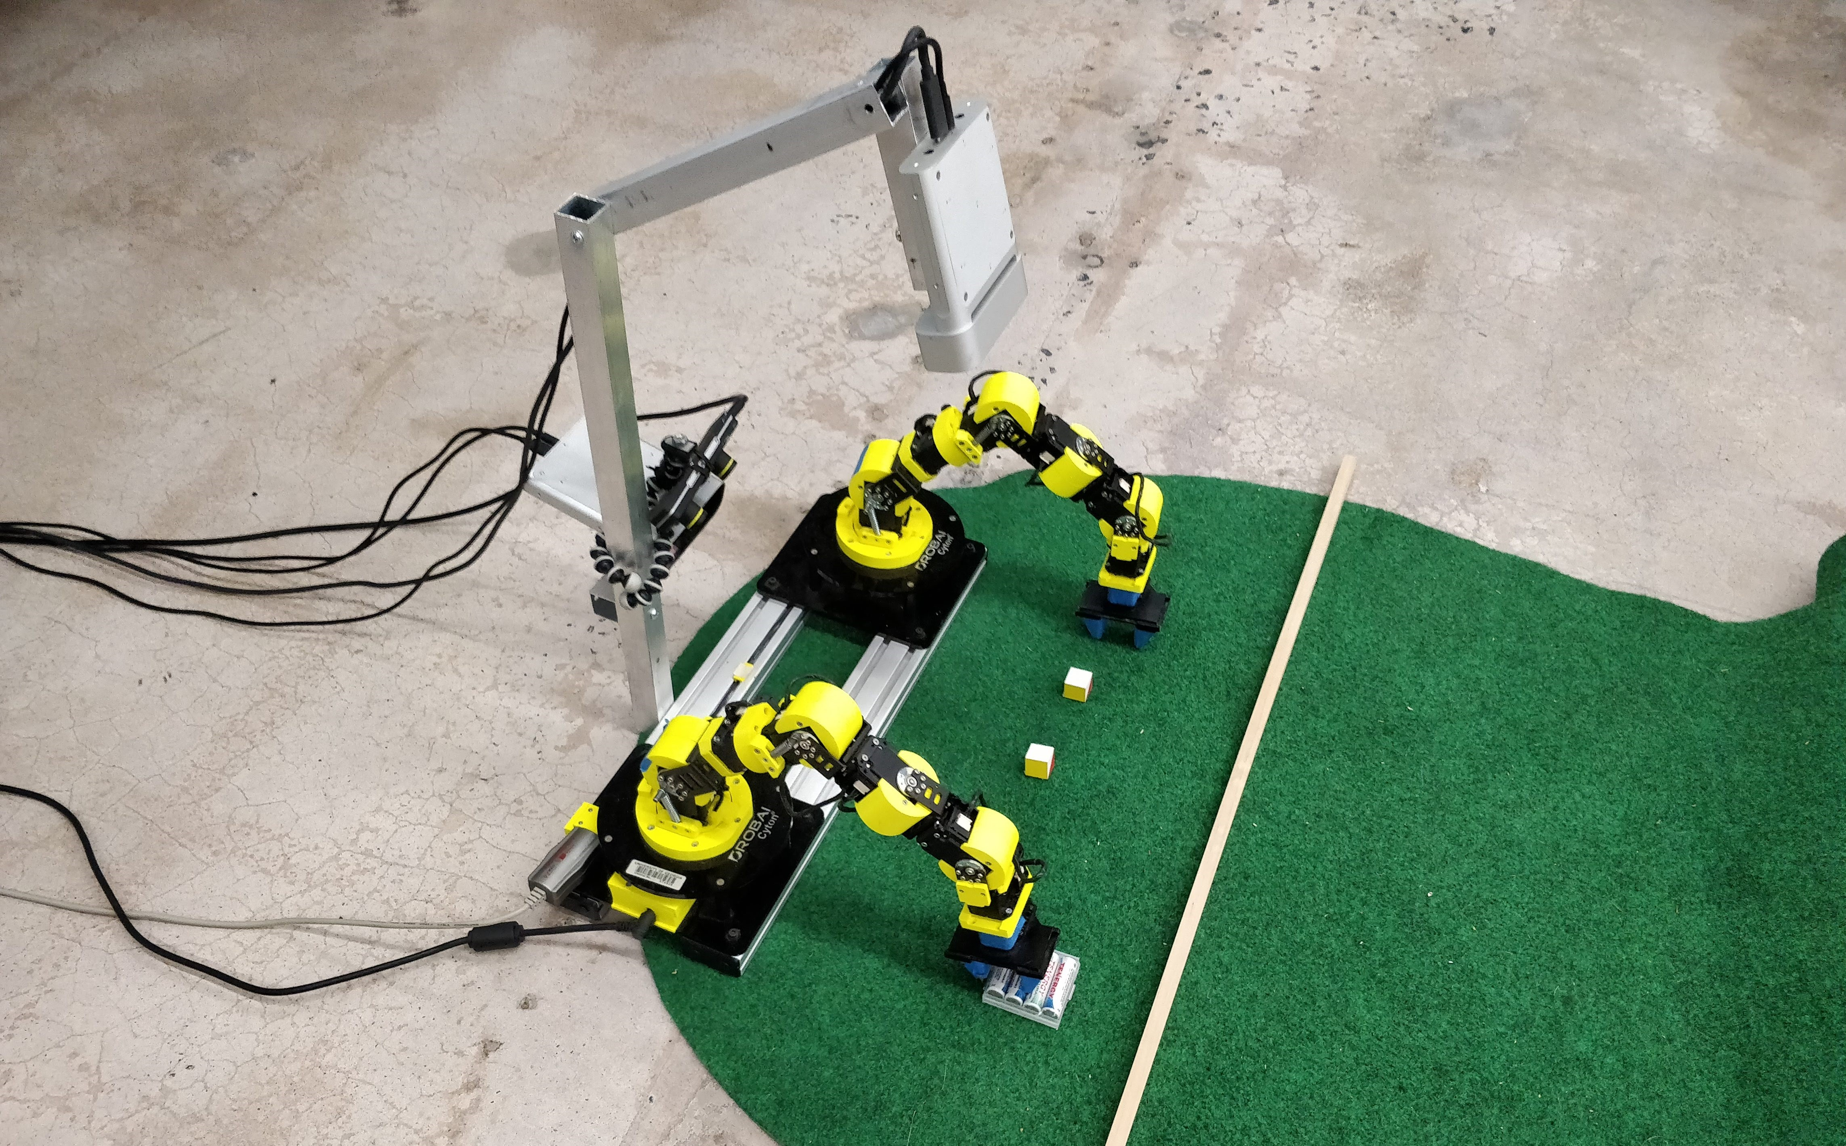
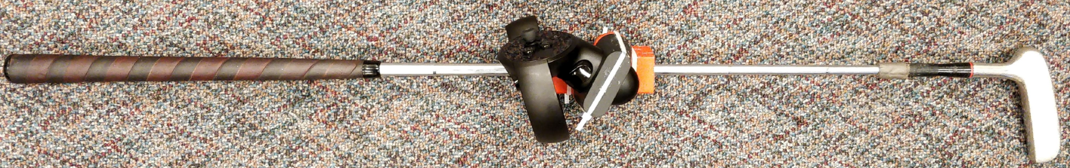
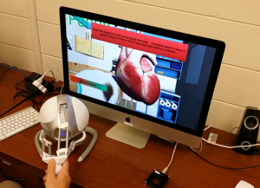
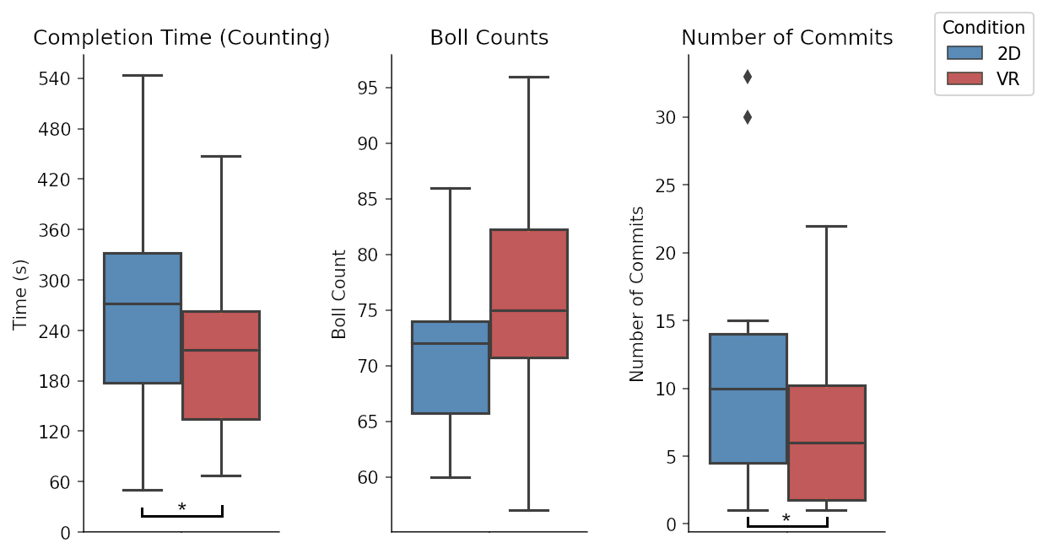
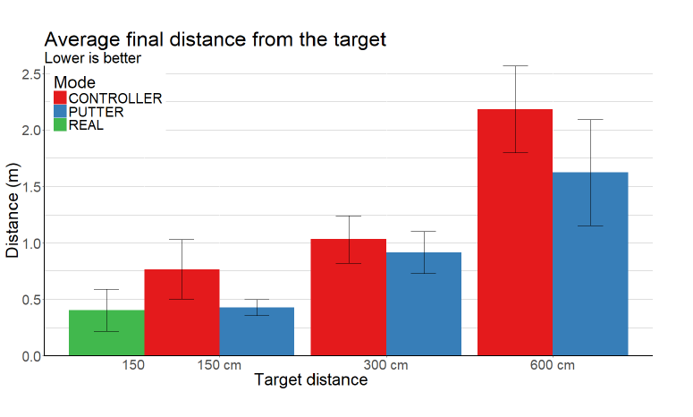
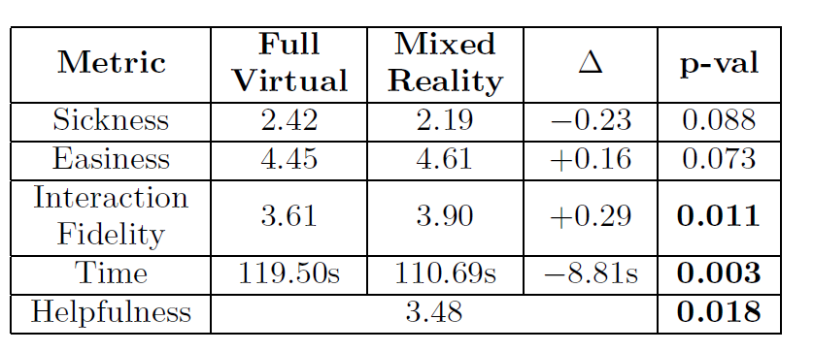
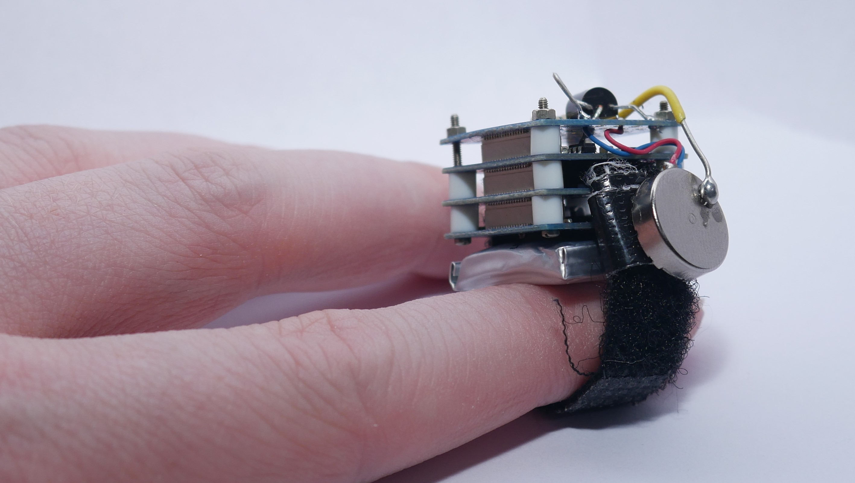
Virtual Experiences Laboratory
Commercial XR Devices
Applications
Custom Design and Integrations
Usability and Impact Research

Slide 3
This talk/demo
Goal - Discuss how and why we moved away from existing networking solutions to focus on the specific needs of own applications.
This talk is most relevant if
You’re using Unity 3D for most of your XR applications
You’re frustrated by existing networking frameworks’ (often arbitrary) limitations or complexity
You’re thinking somewhat big (hundreds of clients)

Slide 4
The Problem
Multi-user XR applications are now becoming the expectation
Widespread XR Meta Quest devices
Pandemic-related interest remote work
Social presence is a major strength of XR
But multi-user XR applications are quite difficult to develop, and especially to deploy
Basic connectivity can be challenging due to firewalls, matchmaking
XR Labs are (usually) not building games
Very little concern for “cheating”
High-bandwidth needs
Often necessary to avoid off-premise servers
Transparency is important
Many small (often unique) applications, lots of iteration

Slide 5
Popular (Unity) Networking Frameworks
Mirror
Open-source re-implementation of the (deprecated) UNET networking platform
Server-Client model of networking
One application instance (server) responsible for synchronizing all other clients
Relays used when the server is behind a firewall
Photon
Commercial
Supports multiple topologies (fusion), but often used for Peer-to-Peer
Cloud-based relay server always used
WebRTC
Primarily designed to overcome peer-to-peer voice/video sharing
Requires a signaling server for interactive connectivity establishment (ICE)

Slide 6
Each has its own concerns
Mirror
Are you going to run all your traffic through a Meta Quest on WiFi?
If not, are you going to redeploy a dedicated server every time you update the application?
And can it run Unity?
Have you also setup a relay server to get around NAT?
Photon
Can you keep your traffic under 500 messages per second and 16 connected clients? (and 60GB / month)
If not, are you willing/able to pay (and still negotiate the limit)?
WebRTC
Can you figure out ICE, STUN, & TURN?
If so, can you also deploy an SFU to avoid upload bandwidth constraints?
And there are others
Unity NGO
Nakama
DarkRift
Normcore
Forge
But all I need a simple broadcast relay server…

Slide 7
Solution: Bring (Photon) Networking in-house
Benefits
Overcome artificial limits and customize
Predictable costs and performance
Strong knowledge of server internals
Potential Issues
Time-to-develop
Server requirements
Re-inventing the wheel

Slide 8
Overview of VelNet
VelNetServer - Photon Server Clone (but without limits)
Emphasis on being lightweight and efficient
VelNetUnity - Enables Unity Object/Component Synchronization
VelVoice - Special Component for Spatial Voice in VelNetUnity
VelConnect - User profile configuration
Also share camera/desktop from web
VelShare - Windows-only, better desktop sharing/control

Slide 9
Broadcast Room concept
All messages go to a “room” on a server known IP
Messages sent to the room are forwarded to other clients
Clients do not need to know about each other
Client 1
Room
Client 2
Message
Message
Message
Note, this is a limited form of how all publish-subscribe systems work (e.g., MQTT, ROS)
Client 3

Slide 10
VelNet Server Features
Server
4
3
Room 1
1
Extremely lightweight
Simple binary packet structure (1 byte header on each message)
Fully asynchronous design (no threads)
Multiple Applications in a Single Server
Lead (master) client coordination
8
Application 1
Room 2
5
6
Application 2
7
Room 3
2
9

Slide 11
Best Features: Simplicity & Portability
Single-file, ~1000 lines of Rust code
Requires 1 open port (TCP & UDP)
Trivial to run almost anywhere
docker run -p 5000:5000 -p 5000:5000/udp velaboratory/velnet
See other options in GitHub Readme
github.com/velaboratory/VelNetServerRust
Runs great on a free-tier Oracle Cloud server (4 core, 24GB, 4Gb/s, 10TB bandwidth)
Easily scales to hundreds of clients in a room, 100+ Mbps, without optimization

Slide 12
VelNet Unity: Photon-Unity-Networking Clone
Owner
Sync Direction
Clone
Abstracts most of the complexity of dealing with VelNet Server directly
NetworkManager
Manages connection with the server
Relays messages
Book-keeping of room state (clients, objects),
Room-level events
NetworkObject
Relays messages from/to its assigned NetworkComponents
Instantiated (cloned) across the network
Manages ownership
NetworkComponent
Sends and receives messages (arbitrary byte arrays)
Sends and receives Remote Procedure Calls
Where most application-level networking lives (netcode)
2
1
1
3
3
2
2
1
3

Slide 13
VelNet Unity Utilities
Handle the common case of synchronizing the state variables of a Unity component
NetworkSerializedObject
Built in loop to get state and send at a specified rate
Optional avoidance of repeated state
Byte arrays only
NetworkSerializedObjectStream
Eliminates the need for manual byte-level serialization
SyncTransform and SyncRigidbody
Synchronizes transform and physics automatically
Configurable to reduce bandwidth

Slide 14
VelNetUnity Demonstration
VelNetUnity is best installed via a custom registry but can also be installed directly through GitHub
GitHub
https://github.com/velaboratory/VelNetUnity.git#upm
Custom Registry
http://npm.ugavel.com (edu.uga.engr.vel)
Samples are available for basic setup with or without voice

Slide 15
VelVoice
Simple voice communications over VelNetUnity
Positives
Portable and easy to integrate as spatial audio
Excellent compression, low latency
Opus Codec (Concentus)
“Free”
Negatives
Performance limited, due to native .NET compression
No echo cancellation or auto-gain
Dissonance (paid asset) integration package is also available in our GitHub
More complicated setup, but better performance

Slide 16
Connection & Configuration with VelConnect
VelConnect solves some difficult XR configuration problems by moving configuration outside of the XR device
Profile setup (Name, Avatar)
Room to join / Link to send others
Sharing from other devices (e.g. phone/desktop)
Process
VelConnectManager provides a pairing code to the user (in XR)
User pairs their phone/desktop (once)
Phone/Desktop can be used for setup
VelConnectManager regularly polls/updates the state
VelConnect can also be used for application-state persistence
Generic Key-Value store

Slide 17
Incorporating Scalable Video Streaming
Video streaming is very useful, especially from a Desktop/Phone
WebRTC is the best option for video communication
Handles complexities of video codec negotiation
The same server used for VelNet can also host a WebRTC “Selective Forwarding Unit” (SFU) for scalability
One streamer, Multiple viewers
Ion-SFU is an excellent Go-based, cross-platform SFU
Web-based signaling server (JSON-RPC)
Share in VelConnect or VelShare (windows only)
Watch with
An embedded web browser (3D Webview)
or with Unity WebRTC (currently limited to 1 stream)

Slide 18


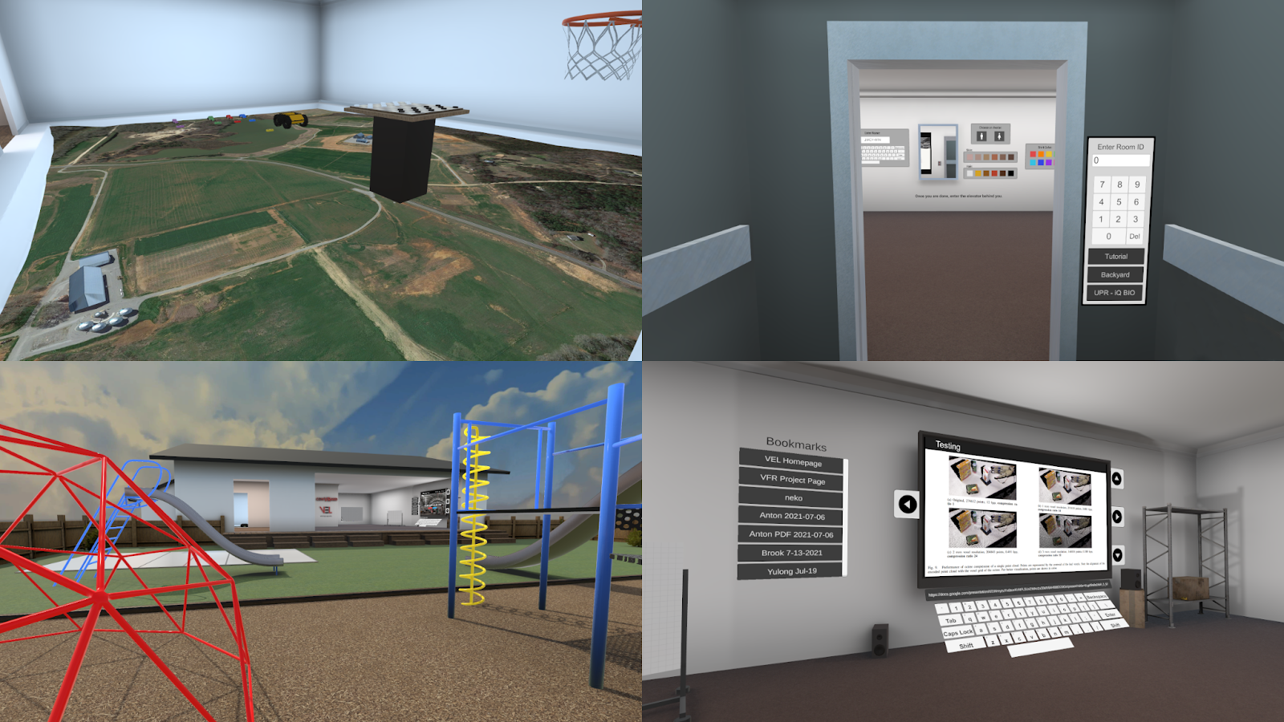
Application VelNet Example:
Multi-application Social XR
Professional Group Meetings
Social Activities
XR Usability Research Studies
Cross-platform
Desktop & VR
Voice, Video, Avatar Communication
VelVoice, VelShare, VelConnect
Available on Oculus AppLab

Slide 19
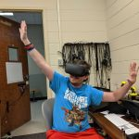
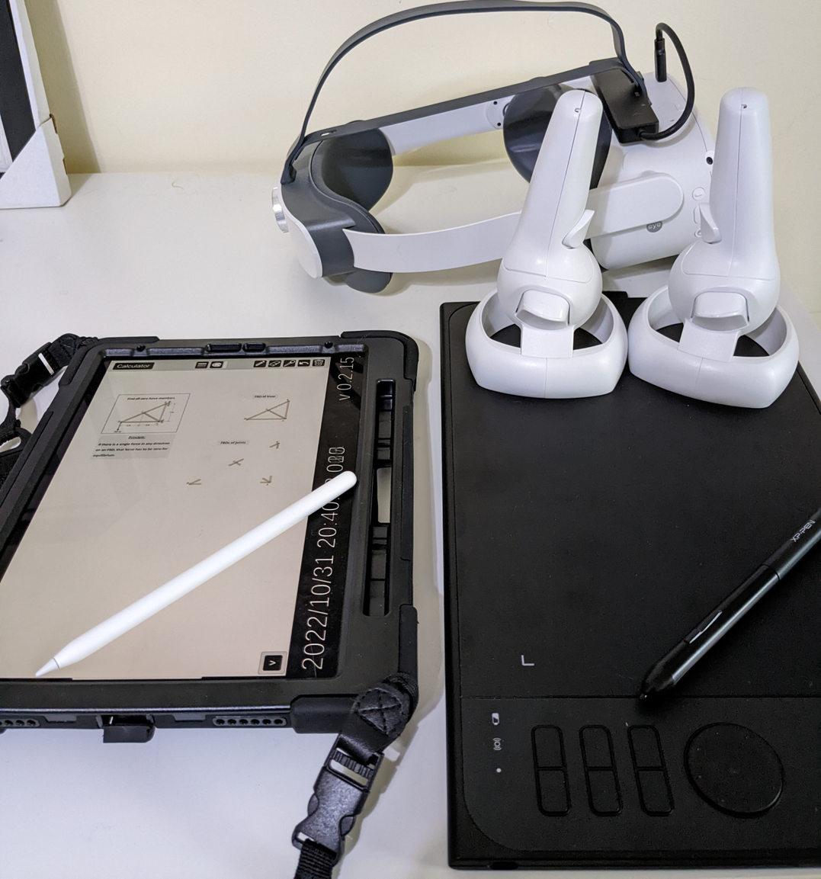
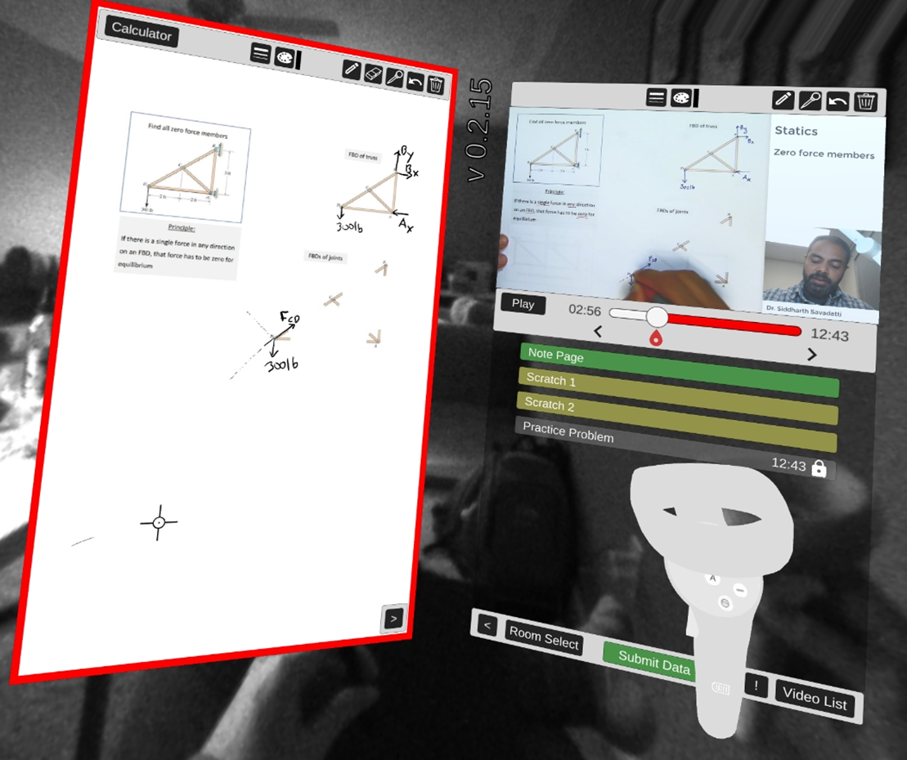
Example VelNet Application: VRDEO
Cross-platform, collaborative problem-solving environment
Voice/Video communication
Synchronized video watching
Synchronized writing/drawing across platforms
iPad, XR headset
Authoring through VelConnect

Slide 20

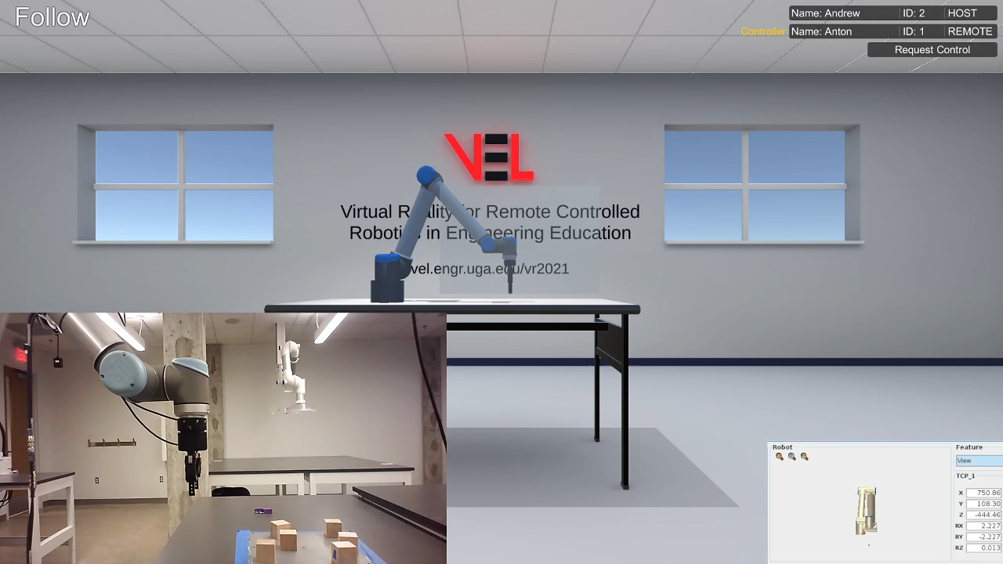
Application Example: Shared Teleoperation of a UR-10 Robotic Arm
Physical Arm - In a laboratory at UGA
Laptop connects the UR-10 (sensing and control) to Unity
Synchronized Digital Twin Simulation through VelNet
Local Clients in AR
Remote Clients in VR w/ Video View of the real environment
Digital Twin used for Teleoperation
Actively migrating to AGX Dynamics

Slide 21
Looking forward to
Server-side
Migrate to TCP/KCP instead of TCP+UDP
Better Auth/Security/Encryption
Unity Side
Simultaneous rooms
Improved support for remote procedure calls
Improved statistics
Libraries for other languages (Python)
More features in VelShare
Multiple streams
Depth camera sharing
AR/MediaPipe integration

Slide 22

Take home points
VelNet’s defining features are
Rapid deployment anywhere (self host)
High performance
Free Open-Source Software
Small code base and conceptual simplicity
No arbitrary limitations
Established paradigm (Photon)
Still a work in progress, and we welcome collaborators
Long-term interest because our deployed products rely upon it
Interested in
Working together?
Hiring excellent PhDs?
Using VelNet?
Using conVRged/VRDEO/Remote robots?
Discord: profkyle#1337
Email: kjohnsen@uga.edu
This material is based upon work supported by the National Science Foundation under Grant Nos. 2032474, 1934481, & 1955049

